Slide 1
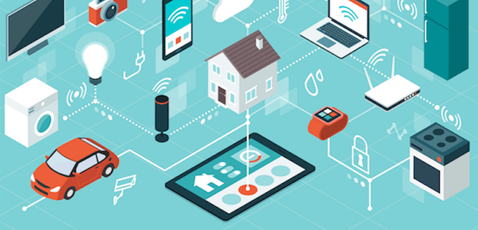
Internet Of Things Project
YAVen-Alat(Smart City Project)

Slide 2

TEAM MEMBERS
1. SANAL MISHRA
2.SARVENDRA KR.SINGH
3.PRABHAT KR. SINGH
4.YASH SINGH

Slide 3
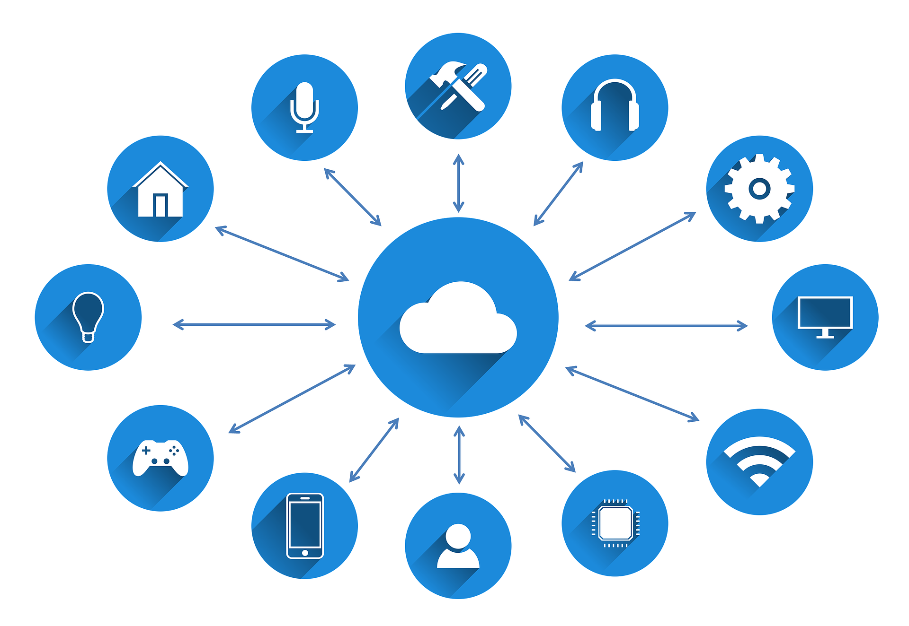
What is iot?
The Internet of Things (IoT) describes the network of physical objects—“things”—that are embedded with sensors, software, and other technologies for the purpose of connecting and exchanging data with other devices and systems over the internet. These devices range from ordinary household objects to sophisticated industrial tools. With more than 7 billion connected IoT devices today, experts are expecting this number to grow to 10 billion by 2020 and 22 billion by 2025.

Slide 4

What is this project?
This invention mainly aims at controlling the disturbances created by young generations. As per the government norms, it is not allowed to make the noise of more than some specified decibels after a specified time to help decrease the level of noise pollution of the country. So whenever this device detects any such disturbances in the locality, it will automatically alert authorities along with the location to handle the situation immediately.
The device also has a speed tracking sensor to continuously monitor the speed of passing by vehicles through the street light. The device will alert the authorities of any over speeding vehicle along with its location. The authorities then can trace the vehicle with the help of an image captured by an embedded camera inside the device.
This device also aims at the concept of controlling air quality and smart street light concept and will run on renewable energy resources. Apart from using renewable energy resources, the device will further save energy as it will dim the light unless it detects any warm body with help of its PIR sensor. Further, the LDR module of the invention will turn off the light in the presence of daylight.

Slide 5

Modules and functionalities
Raspberry-PI to integrate all the components on a single platform.
Sound detection sensor module for Detection of the intensity of sound.
Speed sensor for tracking the Overspeed.
MQ135 for measuring the air quality index in that area.
Camera module for capturing all the activities.
LDR(Light Dependent Resistance) for street lights.
PIR(Passive Infrared Sensor) to detect the movement of warm bodies on the street.
GPS module for alerting the authorities along with the location.

Slide 6

The device(Raspberry pi)
The Raspberry Pi was created with the goal of education in mind. This ultra-tiny computer was designed to be small and cheap so that schools could easily afford them in order to teach students about computers in the classroom. This is great for two reasons, the first is that it provides extremely cheap access to a computer, and second it is a great tool for learning more about computers (student or not)!

Slide 7
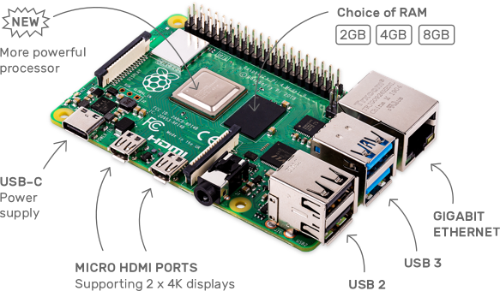
How Does the Raspberry Pi Work?
Here’s how it works:
An SD card inserted into the slot on the board acts as the hard drive for the Raspberry Pi. It is powered by USB and the video output can be hooked up to a traditional RCA TV set, a more modern monitor, or even a TV using the HDMI port. This gives you all of the basic abilities of a normal computer. It also has an extremely low power consumption of about 3 watts. To put this power consumption in perspective, you could run over 30 Raspberry Pi’s in place of a standard light bulb!

Slide 8
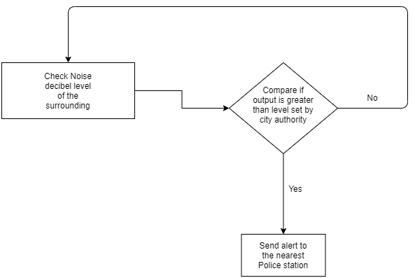
Sound sensor(lm386)
The LM386 is a low power audio frequency amplifier which is very commonly used in small audio amplifiers. The IC consumes very less power and hence can be operated using a 9V battery easily. It can easily drive an 8-ohm speaker with a variable gain of 20 to200. Volume control and gain control is also possible in this.

Slide 9
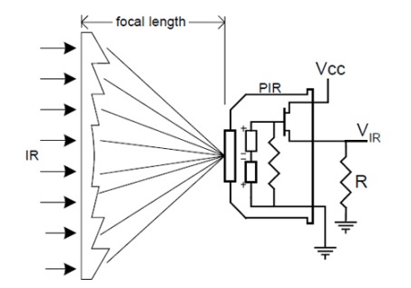
Speed sensor
IR sensors are the basic principle behind this function. The prototype used two IR sensors. Each one of them then detects the motion/presence of ant object near them. The sensor notifies the device whenever it detects any object and records the time stamp for the same. Then the second IR sensor wakes up and detects the body for it to come into its range. The sensor again records the time stamp when it detects the object after it passes through first sensor. The devices calculates the time difference between the two time stamps and uses the pre-known distance between both the sensors to accurately calculate the speed of the object passed.

Slide 10

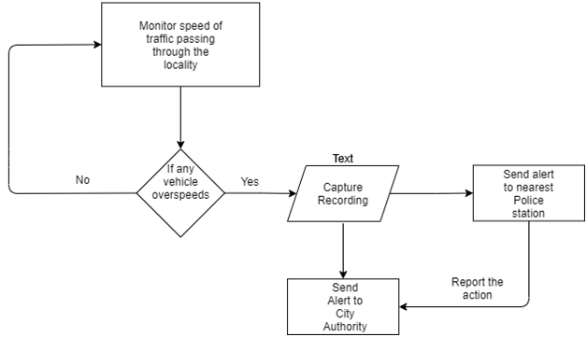
Accident control data flow diagram

Slide 11
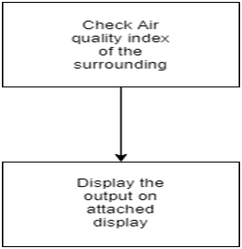
Mq135(air quality monitoring)
It is used to measure the air quality of an area which will be used in this invention to make people aware of their surroundings and help them understand the need to take proper care of the environment.

Slide 12
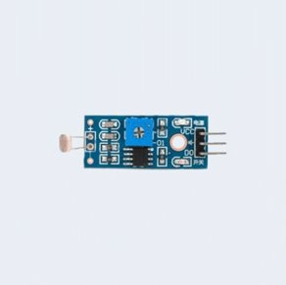
Ldr(light dependent resistor)
The working principle of an LDR is photoconductivity, which is nothing but an optical phenomenon. When the light is absorbed by the material then the conductivity of the material enhances. When the light falls on the LDR, then the electrons in the valence band of the material are eager to the conduction band.
It is used to detect the presence of light in the surrounding so that when the sunsets and it becomes dark, the device could give a signal to switch on the street lights and viceversa when there is sunrise so that no human dependency is required.

Slide 13
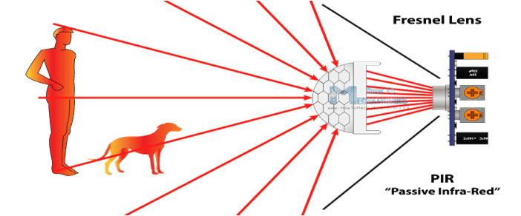
Passive infrared sensor(pir)
PIR sensors allow you to sense motion, almost always used to detect whether a human has moved in or out of the sensors range.
They are small, inexpensive, low-power, easy to use and don't wear out.
For that reason they are commonly found in appliances and gadgets used in homes or businesses. They are often referred to as PIR, "Passive Infrared", "Pyroelectric", or "IR motion" sensors.

Slide 14
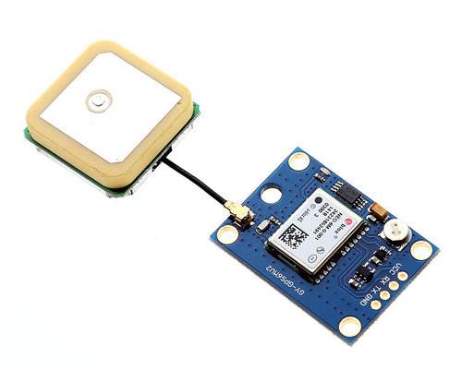
Gps module
GPS stands for Global Positioning System by which anyone can always obtain the position information anywhere in the world.
It is used to determine the exact location of the device so that authorities can easily trace the location.

Slide 15
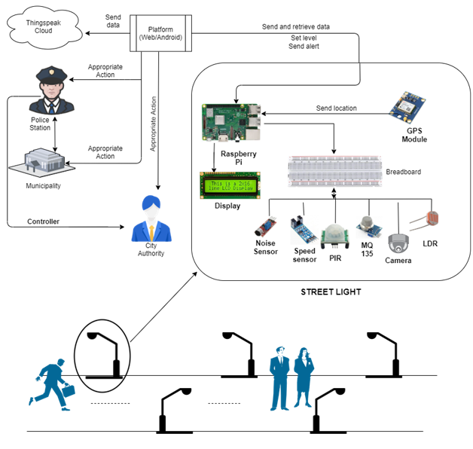
Final layout

Slide 16
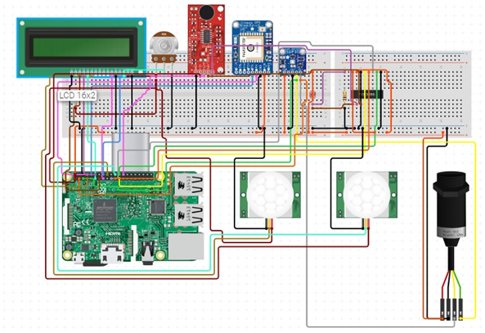
Proposed circuit diagram

Slide 17
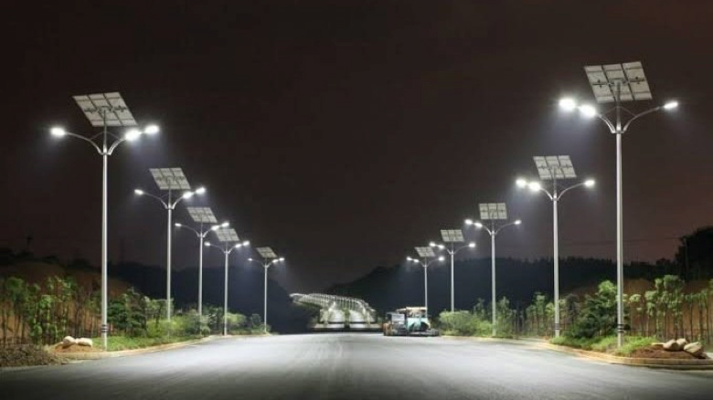
Previous invention
All the ideas which are already implemented are part of the invention of smart city and all the devices are implemented individually. Till now there is no such device in which all the given modules i.e smart street lights, air quality detection, detecting and controlling of noise pollution are embedded into a single device. Also, there is no such invention that can directly report to the government authorities where there is any case of unnecessary noise pollution that may cause disturbance inside any locality. The invention will be embedded inside a street light so that it could track every illegal activity of the locality for a safe and secure environment in the society.

Slide 18

refrences
https://www.raspberrypi.org/documentation/
https://www.silverlineelectronics.in/speed-sensor-arduino-raspberry-pi.html.
Soniya, S., Sindhu, A. R., Manasa, G. S., & Mohan, D. N. IoT Based Air and Noise Pollution Monitoring System in Urban and Rural Areas.
Palkar, P. S. (2019, June). Microcontroller-based Noise Detection and Controlling Electronic Appliances. In 2019 3rd International Conference on Electronics, Communication and Aerospace Technology (ICECA) (pp. 55-58). IEEE.
Liu, J. (2019). U.S. Patent No. 10,290,292. Washington, DC: U.S. Patent and Trademark Office.
Sholanke, A., Aina-Badejo, T., Aina-Babajide, A., & Jacob, A. N. (2019, September). Noise Pollution and Waste Control Techniques in Building Construction in Nigeria: A Literature Review. In IOP Conference Series: Earth and Environmental Science (Vol. 331, No. 1, p. 012016). IOP Publishing.
Reddy, N. J., Sherkhane, N. R., Pravallika, R., & Dinakar, M. J. R. POLLUTION MONITORING SYSTEM BASED ON IOT. amed, A. M. O., Paleologos, E. K., & Howari, F. M. (2021). Noise pollution and its impact on human health and the environment. In Pollution Assessment for Sustainable Practices in Applied Sciences and Engineering (pp. 975-1026). Butterworth-Heinemann.
Bonde, R., Awari, A., Gupta, A., Kadam, A., & Agrawal, R. (2020). Development of Noise Cancellation Device. Development, 7(08).
Sudheer, K., Madhurita, D., Chandana, A., Thanesh, M., & Babu, M. K. (2019). Intelligent Street Light System For Smart Cities. International Journal of Applied Science and Computations, 6(5), 684-690.
Kabir, I., Ahamad, S. U., Uddin, M. N., Hossain, S. M., Farjana, F., Datta, P. P., ... & Hossam-E-Haide, M. (2021, January). GSM-GPRS Based Smart Street Light. In 2021 2nd International Conference on Robotics, Electrical and Signal Processing Techniques (ICREST) (pp. 67-71). IEEE.
Divyapriya, S., Amudha, A., & Vijayakumar, R. (2021). Design of Solar Smart Street Light Powered Plug-in Electric Vehicle Charging Station by Using Internet of Things. Journal of The Institution of Engineers (India): Series B, 1-10.

Slide 19


